Slide 1
Geriatric Robot

Slide 2
Contents
Introduction
Problem statement
Problem solution
Block diagram
Working
Future enhancement
Conclusion

Slide 3
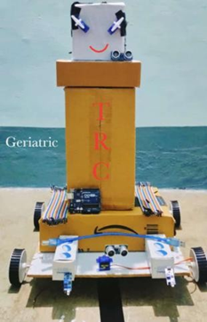
Practical view of robot

Slide 4
Introduction
Care robots are machines, operating partly or completely autonomously, that are intended to assist older people and their caregivers. Care robots are seen as one part of the solution to the aging population, allowing fewer professional caregivers to provide the necessary assistance and care. Despite the potential benefits, the dissemination of care robots, and welfare technology in general, is limited in Swedish elder care.

Slide 5
Problem Statement
Generally an elders faces different health issues and needs proper care . There are not enough care takers by their relatives to meet the growing needs of their necessity and saving elders from lives of loneliness

Slide 6
Problem Solution
Creating an assistant robot, which takes care about the elder people which measures pulse rate, temperature in the emergency situation it sends the information to nearby hospitals and family members through GSM module. This will also provide necessary requirements to the elder people and pregnant people.

Slide 7
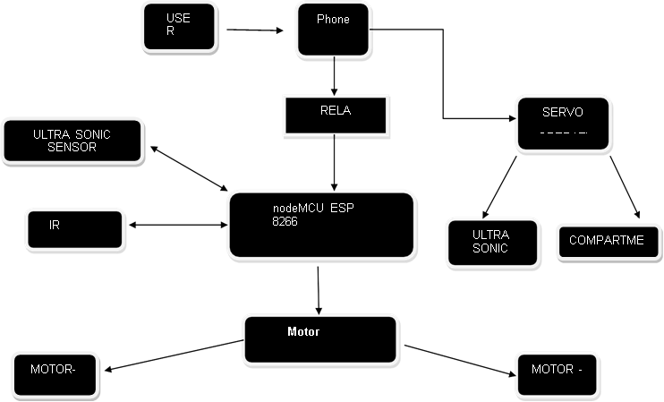
Block Diagrams

Slide 8
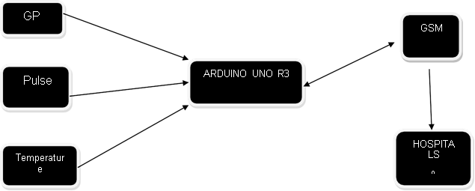
Block Diaagrams

Slide 9
Components Used
Arduino UNO
NodeMCU-ESP8266
Ultrasonic sensor(hcsr04)
IR SENSOR
Servo Motor
GSM Module
GPS Module
Temperature sensor
Pulse sensor
Buzzers
Centre shaft motors
5v Relay Module
12V Batteries
Wheels
L298n Motor Driver
16. Jumper Wires
L-clamps

Slide 10
Softwares Used
Ardunio IDE
Proteus
Fusion 360

Slide 11
Working
So keeping in the mind to take care of the elder people at the time of normal and emergency situation . At first the user needs to give the command to activate the robot ,then the First ultrasonic sensor in bot can detect any hurdles in the path with in range of 40cm, If there is no hurdles in range then it proceed to IR sensors. Two IR sensors are arranged in our bot. they can control the motor here black strip acts as a reference as no object .if IR sensors records 1,0 that means 1 st IR sensor will be on black strip and second it sensor will be on the floor .. then wheels will move in right direction, if IR sensors record 0,1 then wheels will rotate in left direction . Our robot works in 3 degrees of freedom(forward , left , right)by this process the bot can reach to the person then the ultrasonic sensors are rotated in 180 degrees by servo because ultrasonic sensor detects the hurdle(body of the bot) then it stop proceeding of IR sensors then the person will take his required items from bot.

Slide 12
Working
At the emergency situation :
We arrange a belt like structure to the hand which has a capable of handle pulse meter, arduino board, and temperature sensor and gsm module. When the user arranges the belt in his hand and on the module it can take the values of temperature and pulse if at all the readings in abnormal stage the gsm sends the information to the near hospitals and the user can save their life.

Slide 13
Future Enhancement
We need to convert our bot into semi-autonomous to autonomous.
We just want to add features like music ,water delivery system, home cleaning.
We want to make the bot moves by it own using image processing.
We want to make the bot to voice control .
We also want fabricate the li chager circuit on the bot so it can charge on its own when its going to discharge

Slide 14
Conclusion
We need take our grandparents even though we are in the busy schedule. It is possible to need take care our grandparent’s life and save them from saving elders from lives of loneliness by using this interactive bot.

Slide 15


